Slide 1
CS3102 Theory of Computation
www.cs.virginia.edu/~njb2b/cstheory/s2020
Warm up:
Is there anything a human can compute that no “mechanical” computer ever could?
Why or why not?

Slide 2
Humans can compute, but machines can’t
Subjective thing:
Is this delicious?
Perhaps nothing (e.g. if I could perfectly represent a human brain as a program)
Meaning of life
Can humans even do this
42
Quality of art
Quality art looks realistic
Quality of art uses lots of color
Machines can only do what we could write an algorithm for.
You could maybe make a machine mimic an individual’s preferences

Slide 3
Alan Turing’s contribution
What we did this semester:
We have a vague understanding of what a computer is and what it does
We started with our idea of what a computer is, and then tried for formalize that
What did Alan Turing do?
We had examples of computers: Babbage machines, electical computers (Bombe), etc.
He started with the most impressive computer he could think of as the “baseline” for his definition
Humans

Slide 4
Turing Machines
FSA:
Finite number of states,
read-once input,
transition using input bit and state(s)
Turing Machine:
Finite number of states,
Read-once input,
Semi-infinite tape (memory)
Transition using “current symbol” on tape
Can overwrite current symbol, move left/right on tape

Slide 5

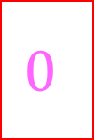
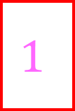

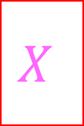

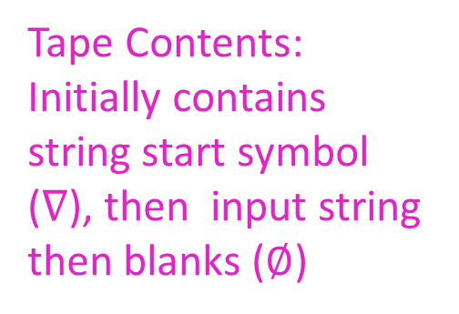
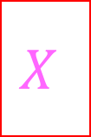

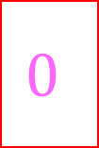

Turing Machine
States, transitions, etc.
FSA
Tape Contents: Initially contains string start symbol ($∇$), then input string then blanks ($∅$)
$$∇$$
$$X$$
$$0$$
$$0$$
$$X$$
$$1$$
$$1$$
$$∅$$
$$∅$$
$$∅$$
…
Semi-infinite tape (memory)
Operation:
transitions outgoing from each state match on current character on the tape, when transitioning you can overwrite that character and move which cell you’re reading
Return 1 if we enter the accept state, Return 0 if we enter the reject state

Slide 6
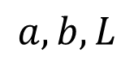
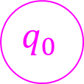

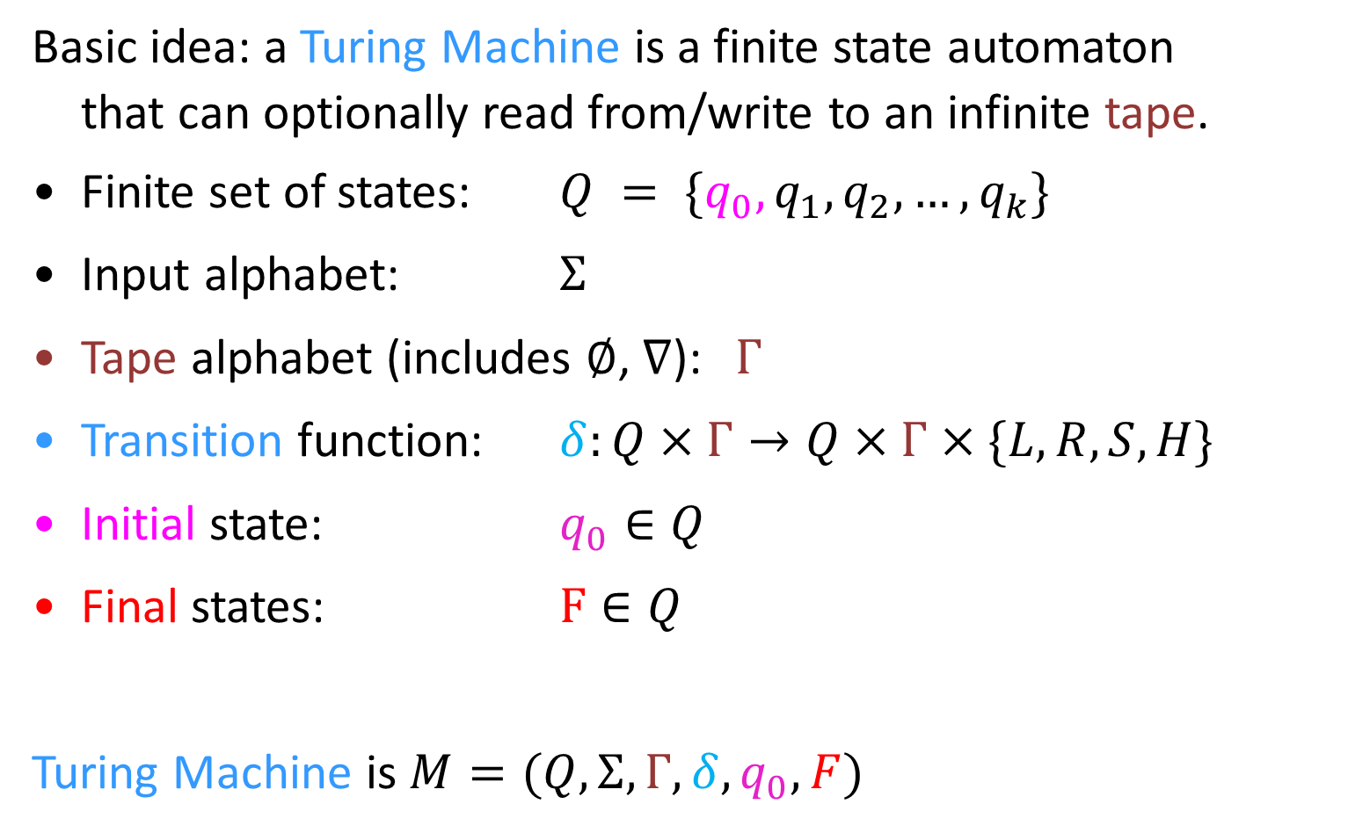
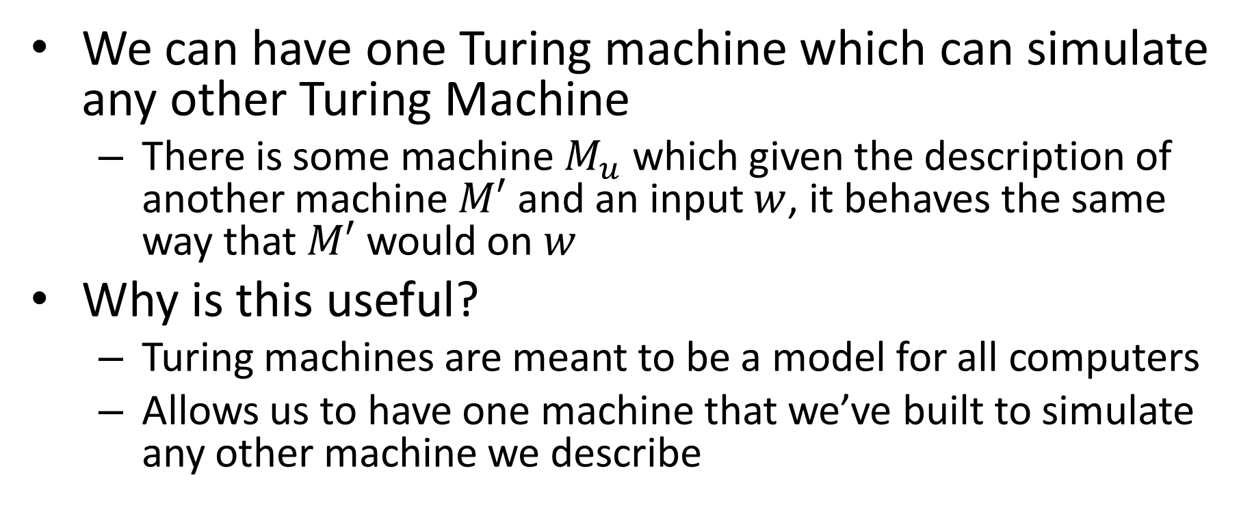
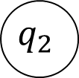
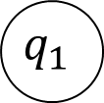
Turing Machine
Basic idea: a Turing Machine is a finite state automaton
that can optionally read from/write to an infinite tape.
Finite set of states: $Q = \{q_{0}, q_{1},q_{2}, …, q_{k}\}$
Input alphabet: $Σ$
Tape alphabet (includes $∅$, $∇$): $Γ$
Transition function: $δ:Q×Γ→Q×Γ×\{L,R,S,H\}$
Initial state: $q_{0}∈Q$
Final states: $F∈Q$
Turing Machine is $M=(Q,Σ,Γ,δ,q_{0},F)$
$$q_{1}$$
Read
Move
$$a, b, L$$
Write
$$q_{1}$$
$$q_{2}$$
$$q_{0}$$
read, write, move
$$A$$

Slide 7
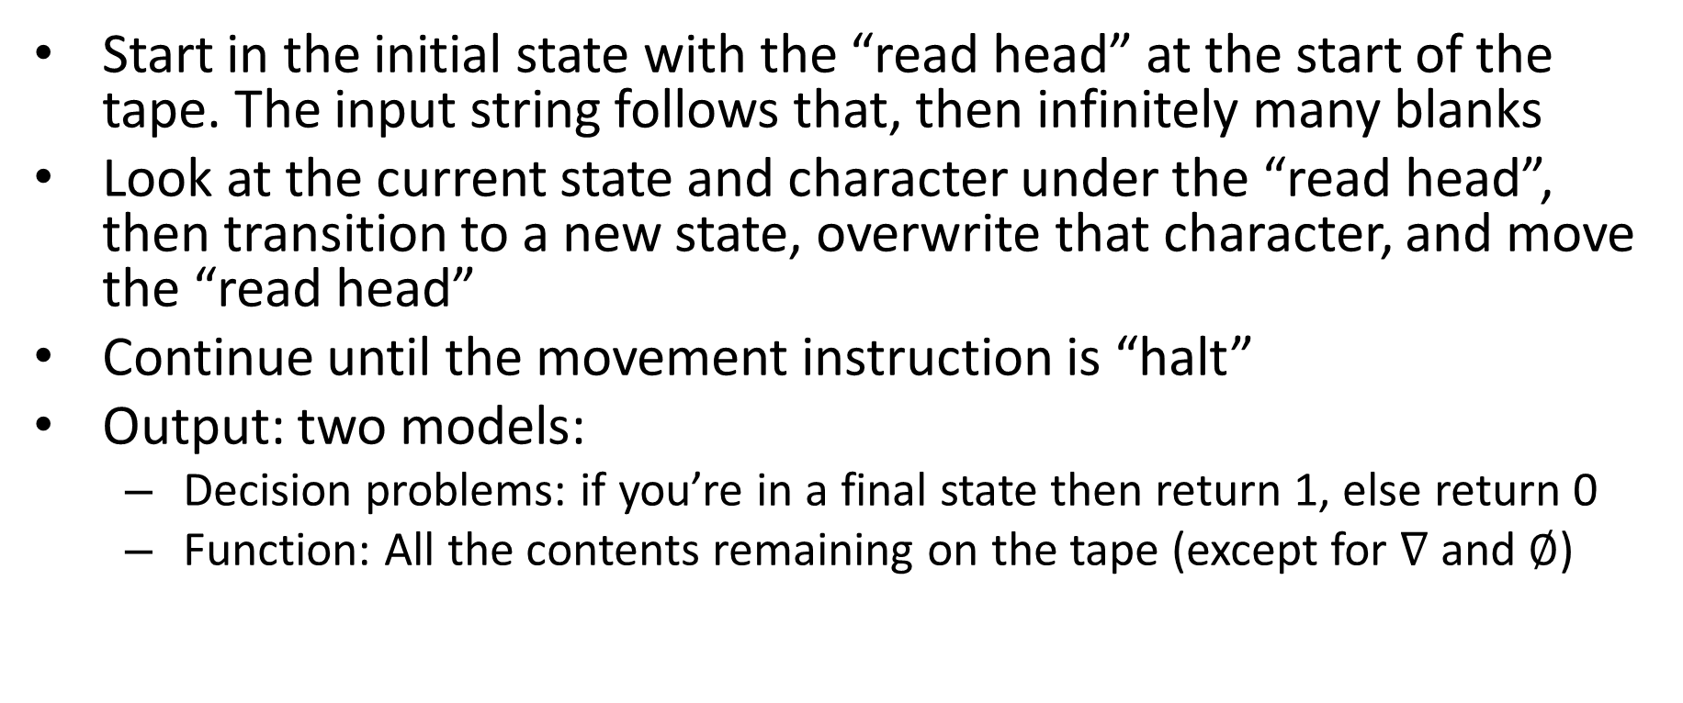
Turing Machine Execution
Start in the initial state with the “read head” at the start of the tape. The input string follows that, then infinitely many blanks
Look at the current state and character under the “read head”, then transition to a new state, overwrite that character, and move the “read head”
Continue until the movement instruction is “halt”
Output: two models:
Decision problems: if you’re in a final state then return 1, else return 0
Function: All the contents remaining on the tape (except for $∇$ and $∅$)

Slide 8
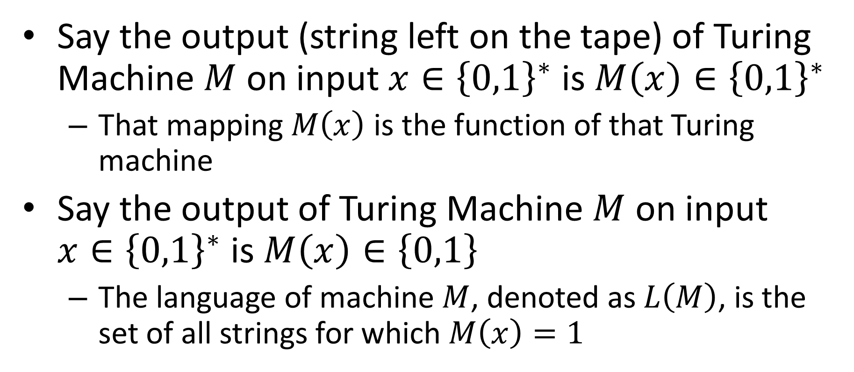
What does a given machine compute?
Say the output (string left on the tape) of Turing Machine $M$ on input $x∈{\left\{0,1\right\}}^{∗}$ is $M\left(x\right)∈{\left\{0,1\right\}}^{∗}$
That mapping $M\left(x\right)$ is the function of that Turing machine
Say the output of Turing Machine $M$ on input $x∈{\left\{0,1\right\}}^{∗}$ is $M\left(x\right)∈\left\{0,1\right\}$
The language of machine $M$, denoted as $L\left(M\right)$, is the set of all strings for which $M\left(x\right)=1$

Slide 9
FSA vs TM
Returns 1 when
FSA: you read the last input character and end up in a final state
TM: you take a halt transition to a final state
Returns 0 when
FSA: you read the last input character and end up in a non-final state
TM: you take a halt transition to a non-final state
FSA: you’ll always eventually read the last character, so they always return something
TM: You can build a machine that, for some inputs, never takes a halt transition!

Slide 10
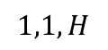

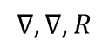
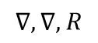
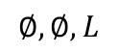
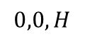
Some Turing Machines never return
while(true){
twiddle(thumbs);
}
In this case they run forever
3 behaviors
Return 1
Return 0
Run forever
This is necessary for computation
while(x != 1){
if(x%2 == 0){
x = x / 2;
}
else{
x = 3x+1;
}
}
$$1,1,H$$
$$∇,∇,R$$
$$0,0,H$$
$$∅,∅,L$$
$$∇,∇,R$$
$$∇∅∅∅…$$

Slide 11
Running forever
Is it a bad thing?

Slide 12

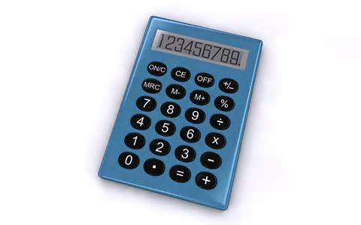
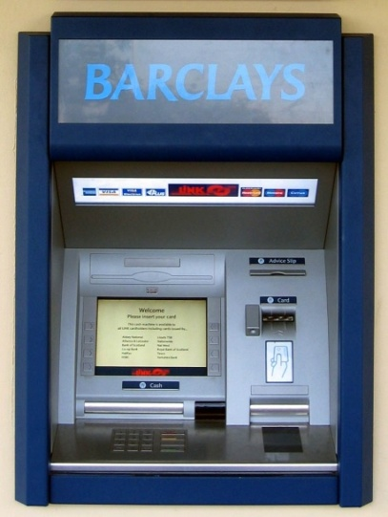



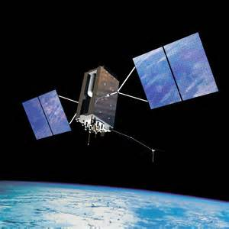
Programs we want to halt:
Programs we want to run forever:
Your 2150 Homework

Slide 13
What is Computable?
Definition:
A function/language is computable provided there is some always-halting Turing machine for it
Function: computable provided there is an always-halting Turing machine which, when run on a tape containing only the input, always halts with only the corresponding output on the tape
Langauge: computable provided there is an always-halting Turing machine which, when run on a tape containing only the input, always halts and returns 1 if that string was in the langauge, and 0 otherwise
Assertion:
This definition is the most powerful definition of computability that is physically possible
Why…?

Slide 14
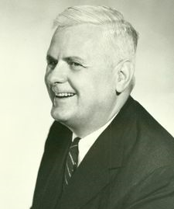
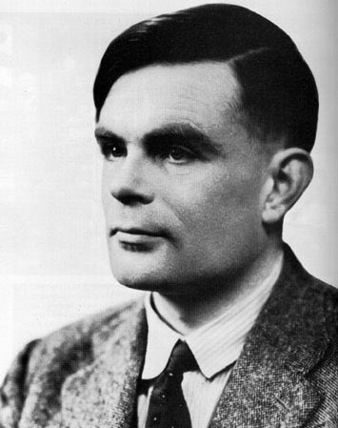
Church-Turing Thesis
A Turing Machine (or Lambda Calculus) can simulate any “mechanical computer”.
Alonzo Church, 1903-1995
Alan Turing, 1912-1954

Slide 15
Thesis?
Axiom:
Something that is not proven, but is so obvious that it doesn’t need to be
Justifiably assumed to be true
Theorem:
A statement that has been proven by a sequence of axioms
Thesis:
A philosophical statement, that is justified with an intuitive (yet compelling) argument
A statement that is too open-ended to be approached by formal mathematics

Slide 16
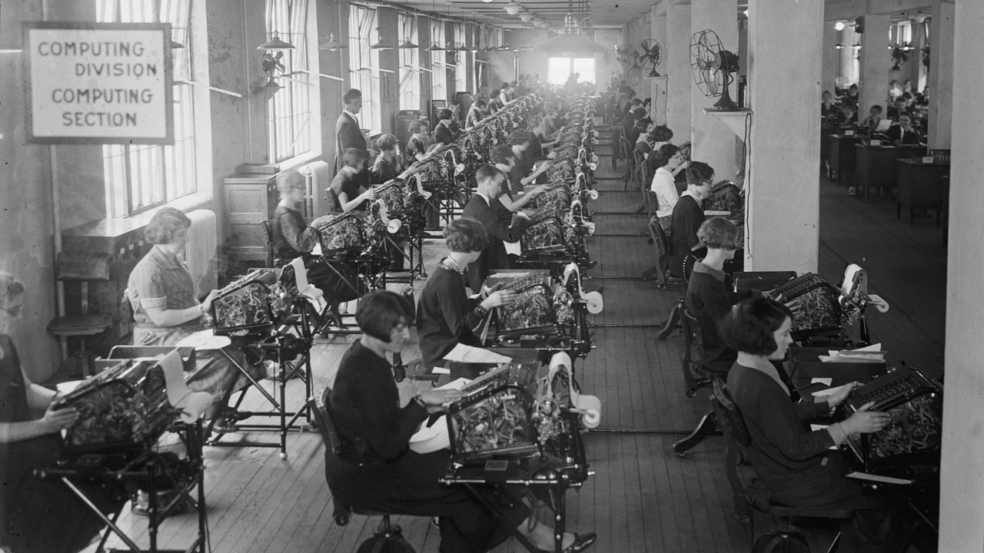
Bonus Bureau, Computing Division, 11/24/1924
https://www.loc.gov/pictures/item/2016838906/
Notes:
Calculating bonuses for veterans

Slide 17
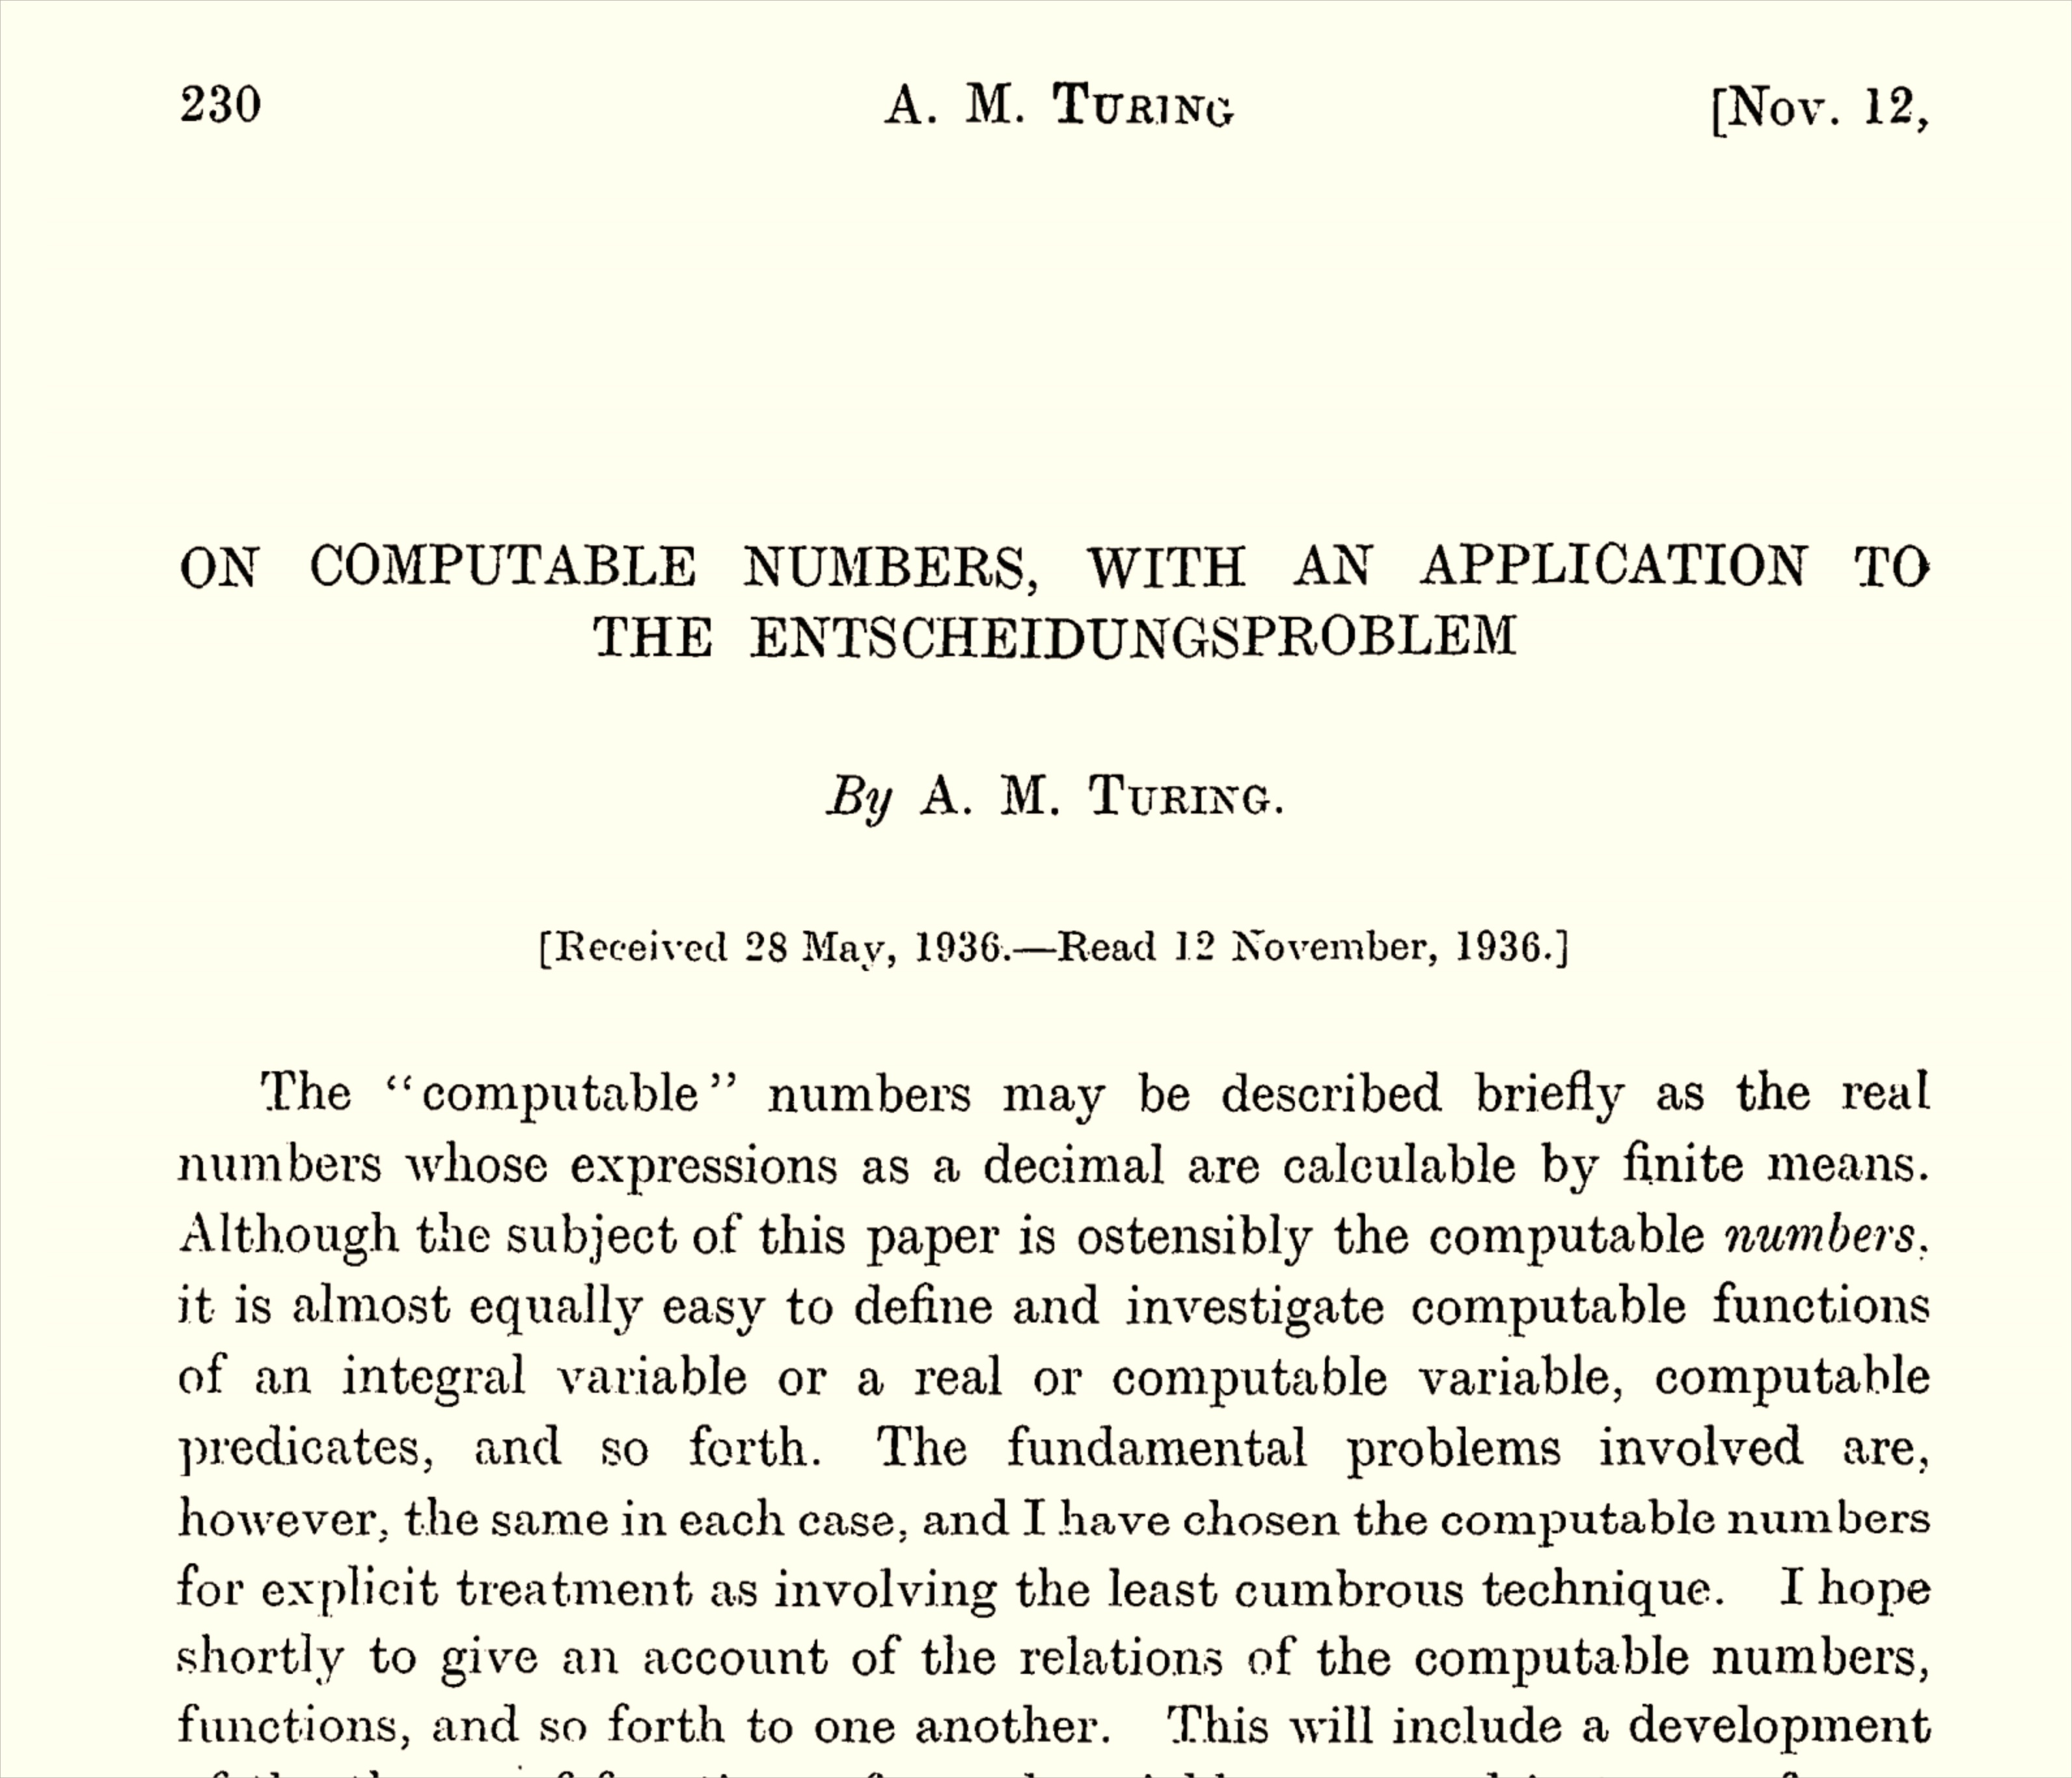

Slide 18
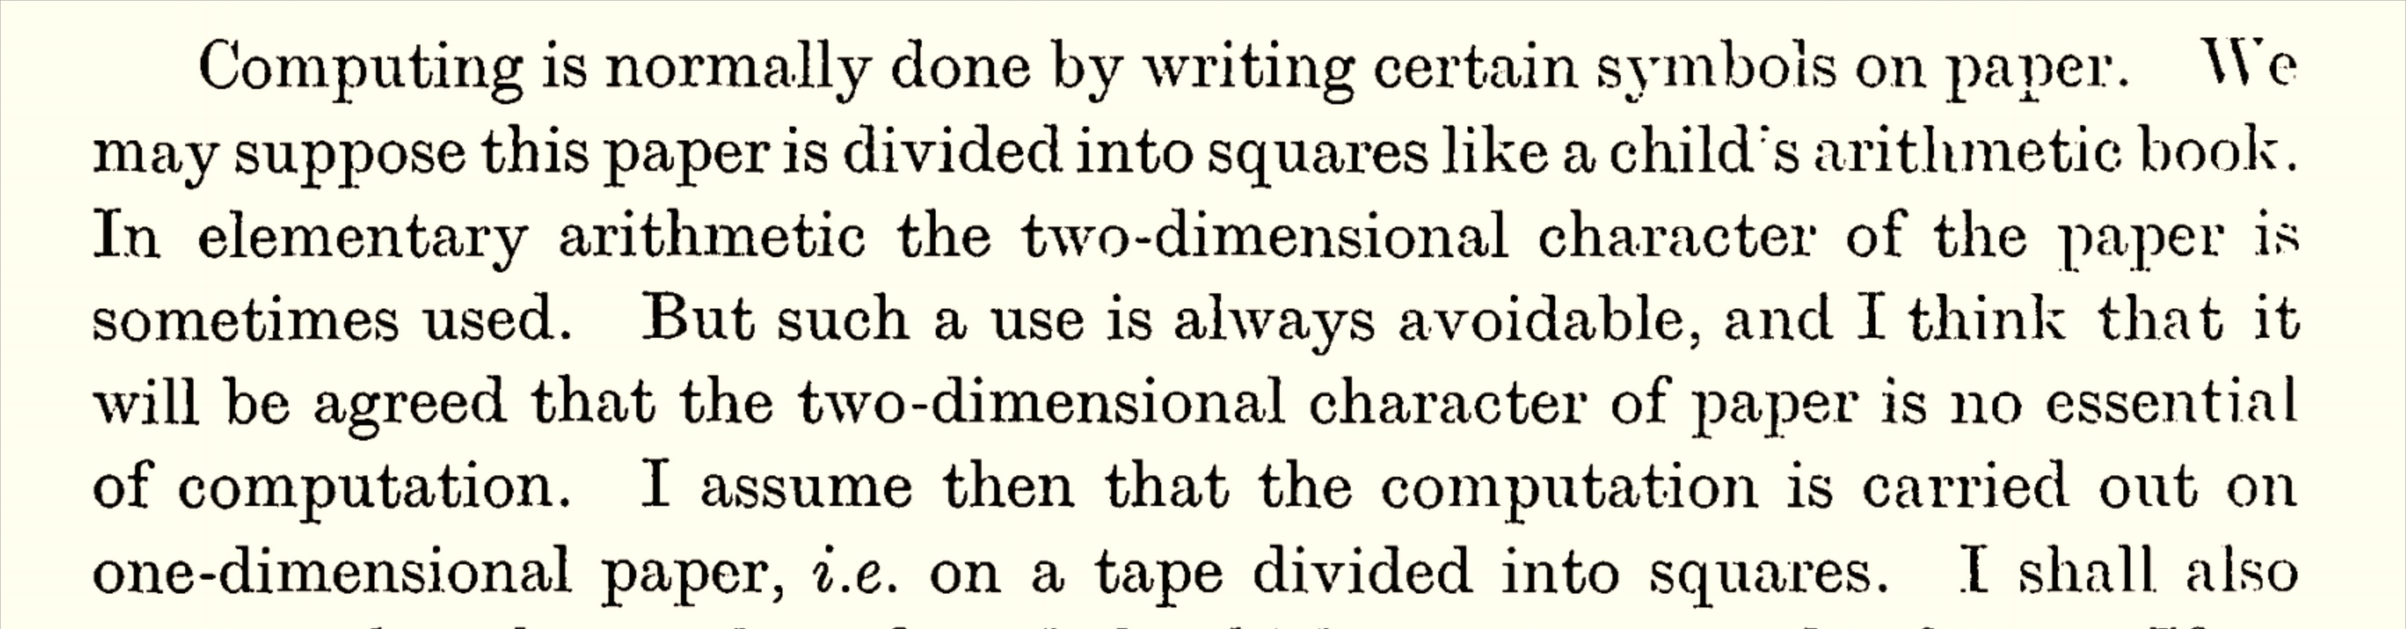

Slide 19
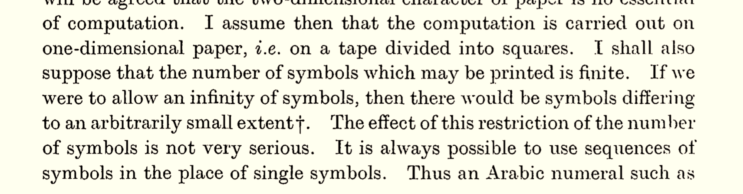
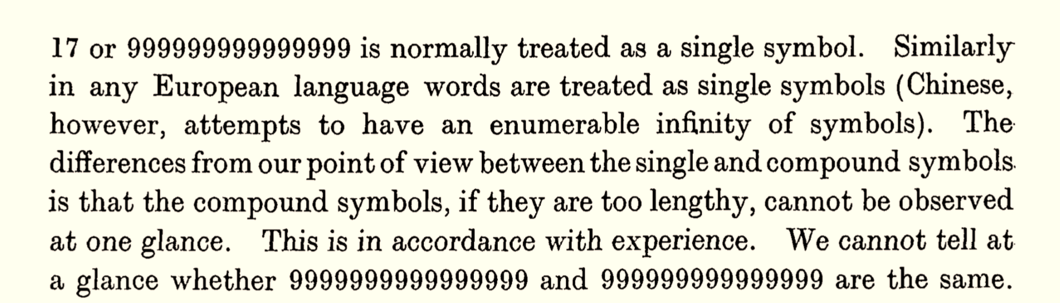
Why is the alphabet finite?

Slide 20
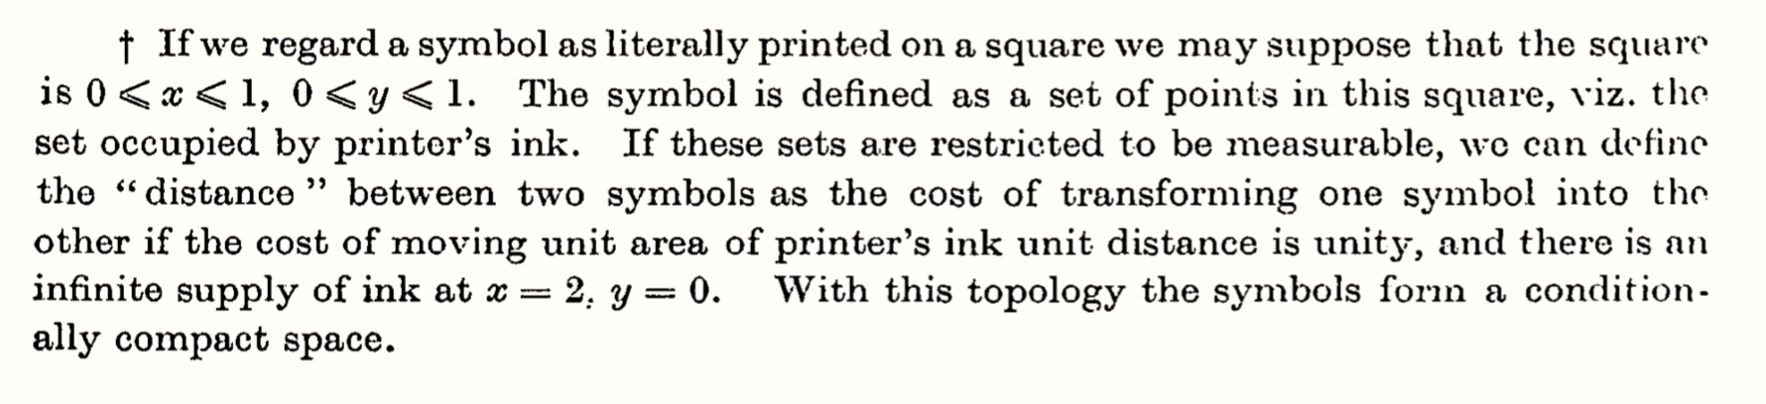
Why is the alphabet finite?

Slide 21
Why is the alphabet finite?
Recognizing/distinguishing symbols should be “quick”, it shouldn’t require its own “computation”

Slide 22
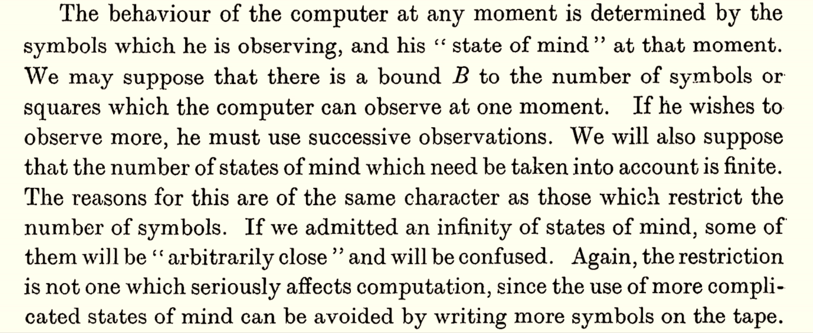
Why is the number of states finite?

Slide 23
Why is the number of states finite?
The states in the machine represent the “state of mind” of a human.
Humans should only be able to have a finite number of “states of mind”
Your “state of mind” must be in your brain, and your brain has finite volume/mass/matter/stuff

Slide 24
Turing machine
Before: Human with “states of mind”, typing on a typewriter with finitely many “keys”, working on a piece of paper
Model: finitely many states, finitely many characters in an alphabet, linear tape for memory, the human can change the tape, the tape can influence the human’s state of mind

Slide 26
What can a Turing Machine compute?
For sure:
Any Java/Python program
If the Church-Turing Thesis is Correct:
Anything that a human can compute
Some evidence that it might be correct:
Simulating a nematode

